Slide 1

Exploratory Data Analysis: COVID-19 Spatial Data
Stephen Chong Zhao
Oct. 31st, 2023

Slide 2

Introduction
Topic: COVID-19 Pandemic
Dataset: WHO COVID-19 Data
Motivations:
Which countries have been affected by COVID-19 at a given day?
Do countries report new cases everyday?
Is there a direct correlation between severity of the pandemic and population (size/density)?

Slide 3

Data Description
Source: World Health Organization (WHO)
Timeliness: Updated daily since January 3rd, 2020
Cut-off date: October 25th, 2023
Important Features:
Country/Region Names
Total Cumulative Cases/Deaths
Daily New Cases/Deaths
Report Dates
Population estimates and area of region
Merged from Geopandas “Natural Earth” dataset

Slide 4

Exploratory Analysis

Slide 5
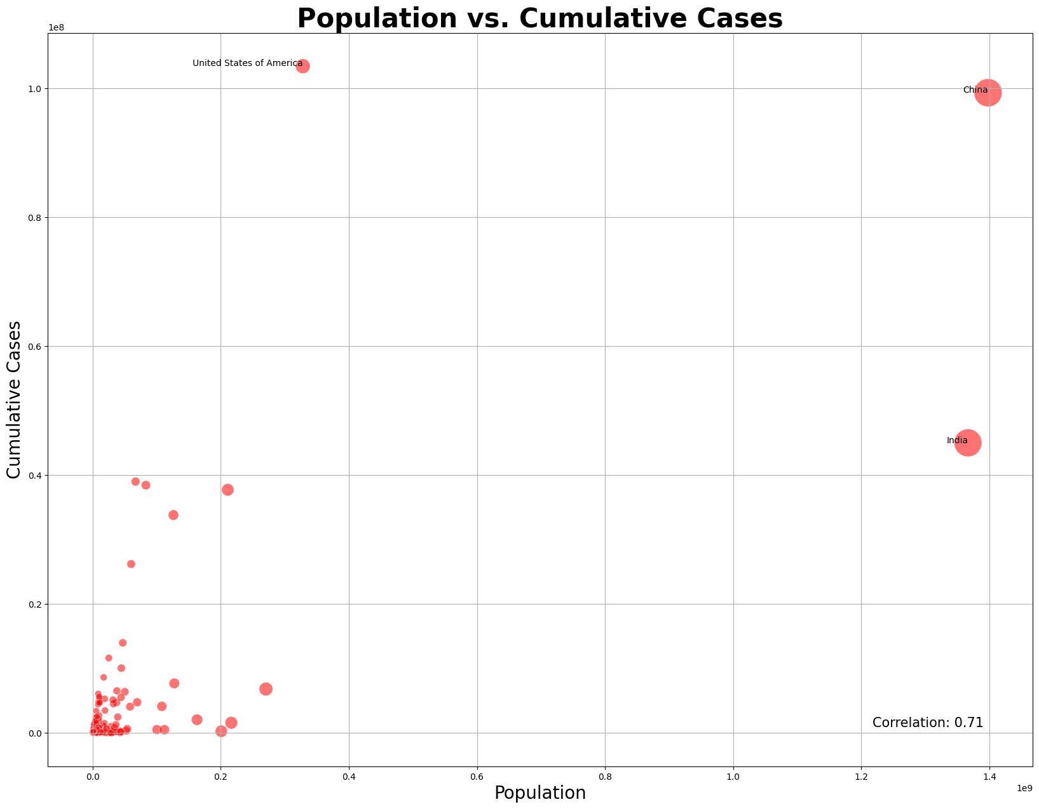
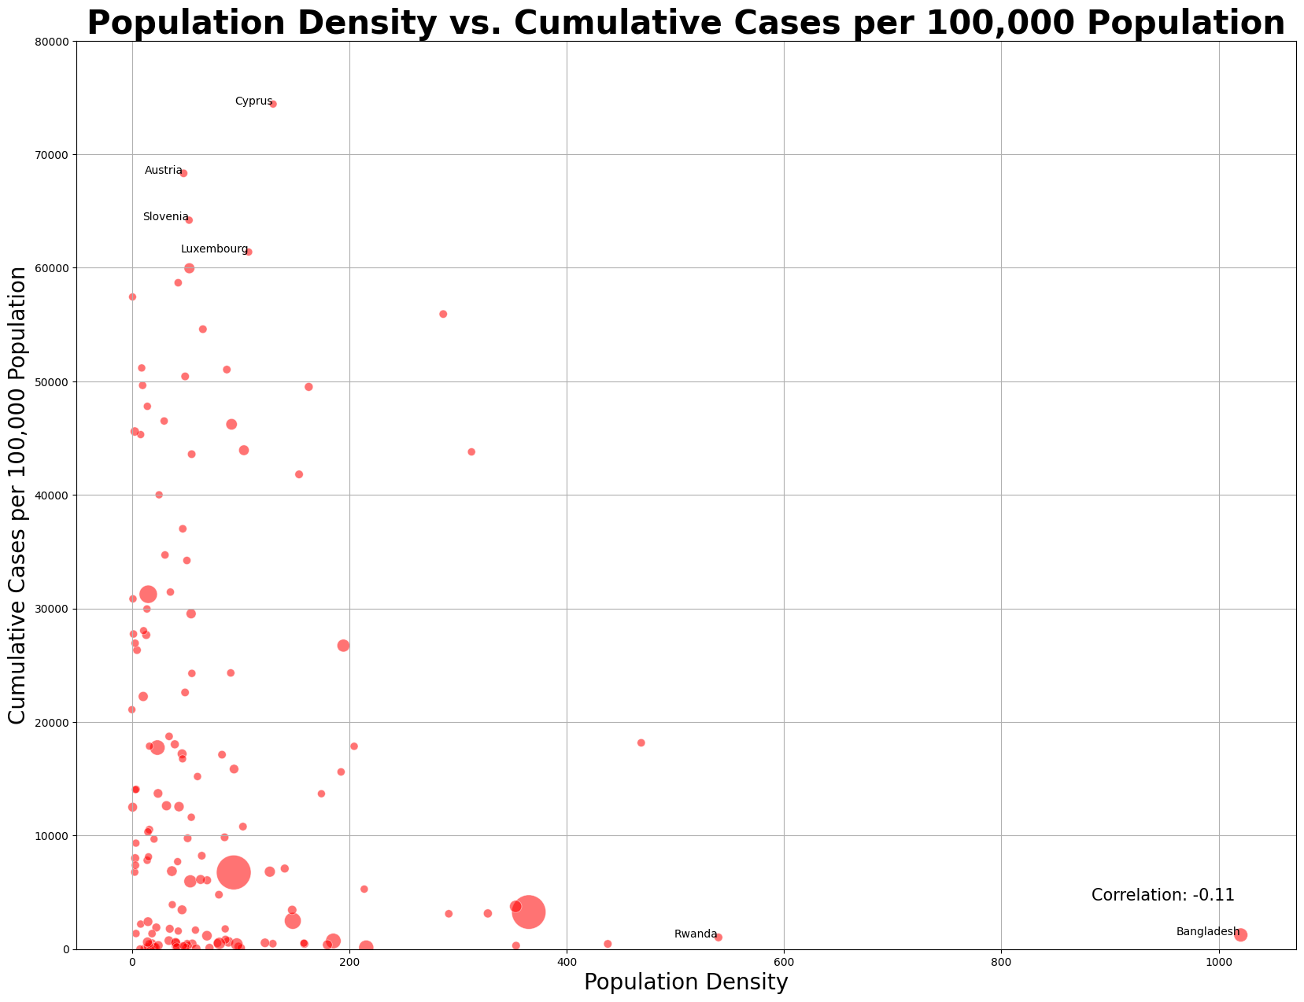
Population & Cases
Positive correlation population size and total cumulative cases within a country
No strong correlation between population density and Infection Rate within a country

Slide 6
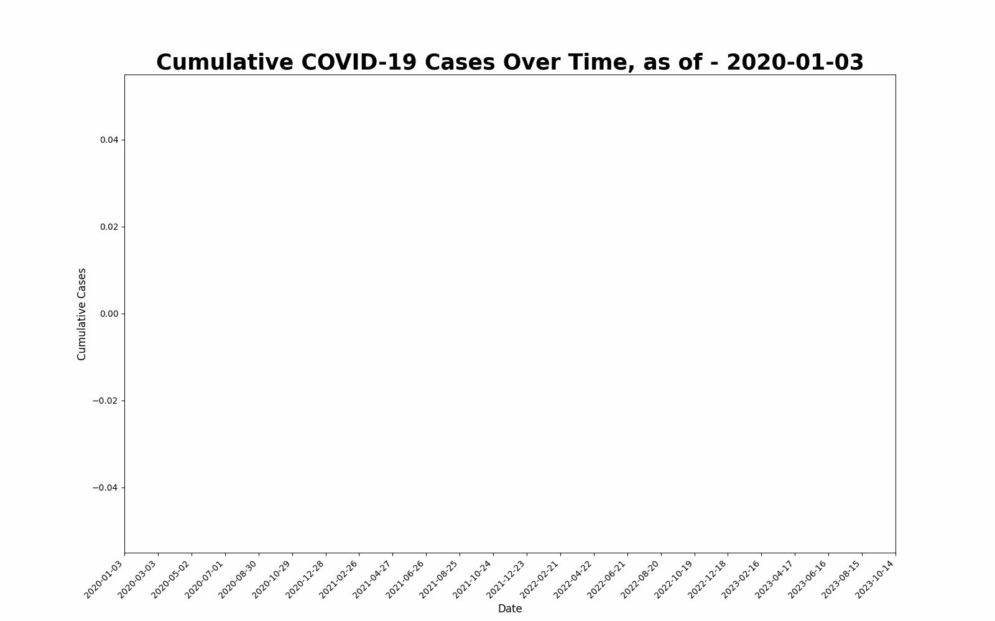
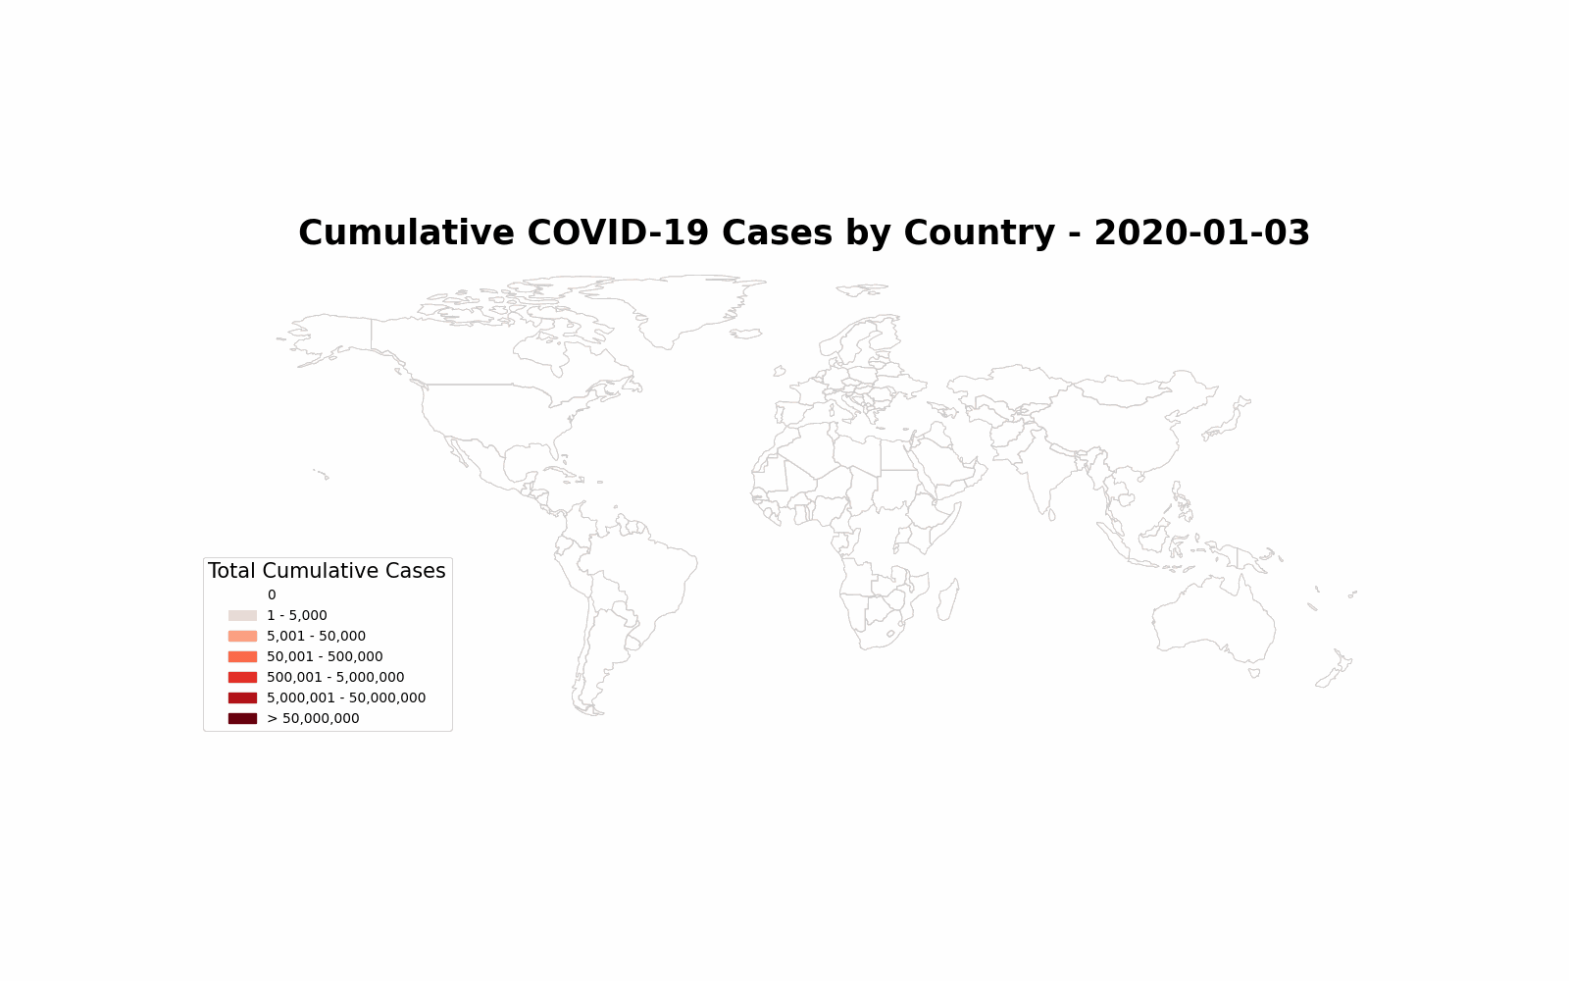
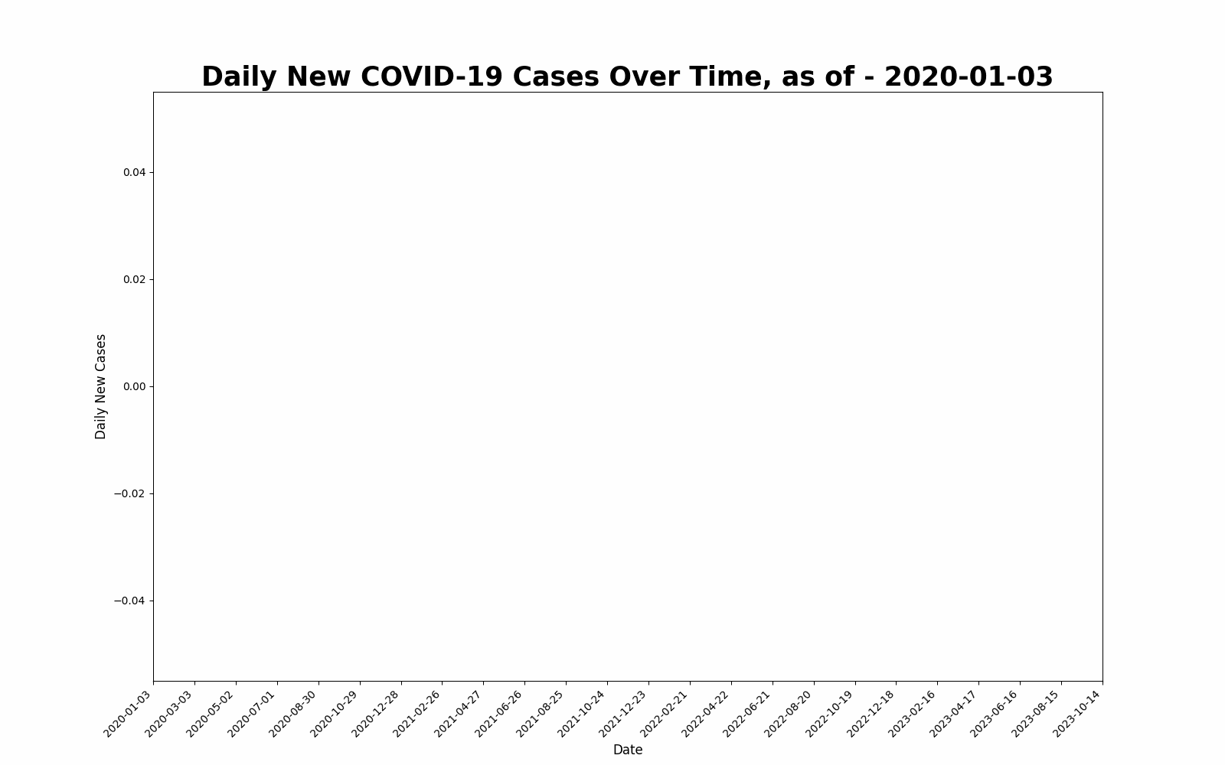
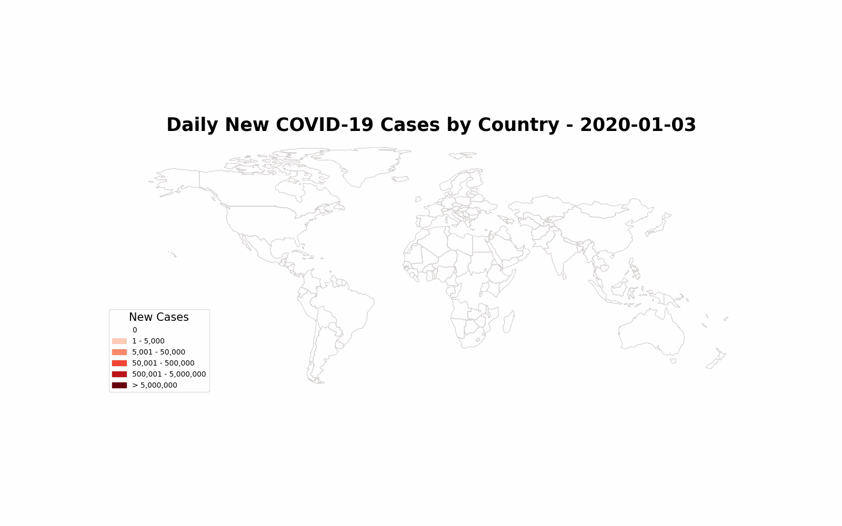

Slide 7
Takeaways

